Slide 1
SQL Databases

Slide 2
What is a database?
A database is a… base… where you keep all of your data…
A large data structure that stores all non-programmatic data long term
For example, the code for your favorite game runs code on your client, and code on the server, but your player information is stored in a separate location outside of the game code.
Databases typically have a piece of software (server) that allows other programs to access the data
MySQL, MongoDB, MariaDB

Slide 3
What kinds of Databases are there?
There are many, but we will focus on:
Relational Databases – a database with many tables containing data related to each other.
Flat File – a database with one table, stored in a text file

Slide 4
What does SQL stand for?
Structured Query Language
Accessing a database with a predefined Structure
by making Queries
Using a predefined set of commands, or Language
SQL is a common language that many different database servers use to access their data.

Slide 5
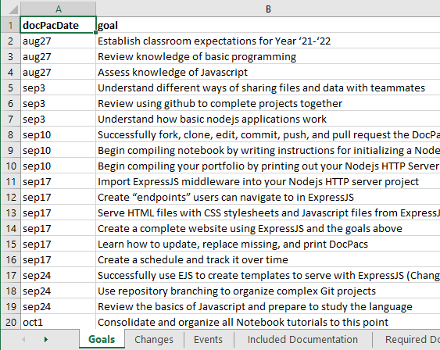
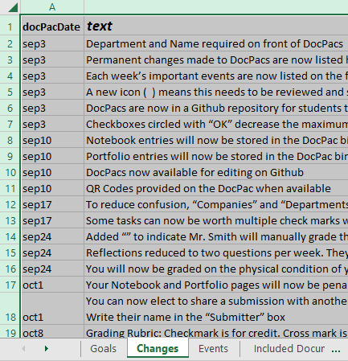
What does a relational database look like?
Probably like this:

Slide 6
What makes a relational database?
A relational database is one that you ask out, and they always say they would go out with you except they’re “in a relationship”, and every time you ask they seem to be in a relationship with someone else, and now you’re starting to think they’re not in a relationship at all and they’re just too afraid of rejecting you proper.
A single database with a variety of tables.
Uses “keys” to connect rows from different databases.
(collects data by how each rows “relates” to the others)
For example, all rows can be connected by their DocPac Date
We will practice JOINs later

Slide 7
What makes a relational database? Pt2
Pros:
Can hold immense amounts of data.
Can hold a wide variety of data.
Every item, spell, buff, class mechanics, mob, and quest in World of Warcraft is stored in a relation database.
Cons:
Requires a specialized interface, such as SQL, to access specific data because there is so much.
Often requires separate server software.

Slide 8
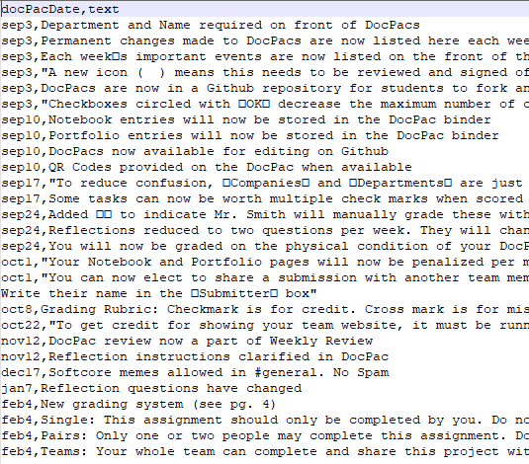
What does a flat file look like?
Probably like this:

Slide 9
What makes a flat file?
A text file, such as a CSV file or JSON file
Has a syntax to separate and organize data
That’s really it.
Pros:
Extremely easy to use, read and edit manually.
Doesn’t require any extra software.
Cons:
Reading and writing are very slow, can cause corrupt data
Limited by how much data you can hold in memory during program run time

Slide 10
What is SQLite3?
A type of database that uses memory or a “.db” file
Doesn’t require special server software
Limited SQL command set
Doesn’t need to be loaded into memory
Easiest way to start working with SQL databases
Use DB Browser Lite to easily create, edit, and test SQLite3 databases

Slide 11
BREAK 1
Write down your answers for 1-7 and Break 1 on your Notes Sheet

Slide 12
sqlite3 npm module
NPM hosts a NodeJS module called ‘sqlite3’
Provides a list of methods you can use to access an sqlite3 databases using SQL
Remember that there is no software running a sqlite3 database. It’s just a file.
SOMETHING has to parse the SQL query
Think of it as server database software
You have to learn SQL and the sqlite3 API
These are two skills that stack

Slide 13
Using sqlite3
Create a database object from sqlite3’s Database class
let db = new sqlite3.Database('sql.db', (err) => { console.log('Connected to the db database.’); });
The Database class has many useful methods:
run() – Run an SQL query that doesn’t necessarily return data
INSERT, UPDATE, CREATE, DELETE
get() – Return the first row/match that meets the Query parameters
all() – Return an array of all rows/matches that meet the Query parameters
each() – Like all, except it runs the callback function like a for loop
serialize() – Run each method in this one synchronously

Slide 14
sqlite3 callbacks
All sqlite3 Database methods are asynchronous
You don’t want to wait for each SQL Query when you have thousands of users trying to access your website
Callbacks are functions that run when the Query is complete
This is where you would parse the returned data, validate it, and return an HTTP response to your user.

Slide 15
BREAK 2
Write down your answers for 1-7 and Break 1 on your Notes Sheet

